Slide 1
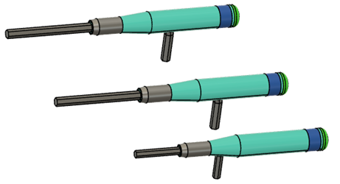
Mikes’s Fusion 360 class Module 3 - Using Parameters
Anyone who has used Fusion 360 and typed in a dimension somewhere, has used a parameter. Most designs are full of them. But parameters in fusion can be a lot more than just typed in numbers. They can help you to become a “lazy designer” by enabling you to make your designs easily adjustable, saving you loads of time.
In this module, we’ll take an in-depth look at how parameters work in Fusion 360, and walk through an example of how to use parameters to design a set of 3D printable allen wrench handles that can be easily adjusted based on the size of the wrench.

Slide 2
Using Parameters - Class prep
What you should already know before class starts
Fusion 360 Design User Interface functions and how to use them
Data Panel, Component Browser, Timeline, Design workspace
View manipulation (rotate, zoom, etc)
Component model
Creating new components, components vs bodies
Basic part design workflow
Sketch → create body → edit steps from timeline or component browser
Saving your designs, uploading designs
Please come to class prepared to participate
This is supposed to be an watch/talk/do class, not a lecture.
Have Fusion 360 up to date and running when class starts.
Use two screens if you can, or else set zoom to not be full screen.
At the beginning of class, I’ll have the example file for you do download through Zoom and upload into Fusion.

